Slide 1

An Implementation of the AES Block Cipher in Python
B. HEMANTH CHOWDARY(192211206)
K. CHARAN VENKATA KRISHNA(192211133)

Slide 2


Introduction to AES Block Cipher
The AES (Advanced Encryption Standard) block cipher is a widely used symmetric-key algorithm for secure data transmission. It provides robust encryption through a series of mathematical operations, making it a crucial tool for protecting sensitive information in various applications.
by Charan

Slide 3

Overview of AES Algorithm
Block Cipher Structure
1
AES is a symmetric-key block cipher that operates on fixed-size blocks of 128 bits. It uses 128-bit, 192-bit, or 256-bit keys to encrypt and decrypt data.
2
Rounds of Transformation
The AES algorithm applies a series of transformations, called rounds, to the input block. The number of rounds depends on the key size, ranging from 10 to 14 rounds.
Core Operations
3
The core operations in AES include SubBytes, ShiftRows, MixColumns, and AddRoundKey. These operations are designed to provide confusion, diffusion, and key-dependency.

Slide 4



AES Key Expansion
Round Key 0
1
Initial key
Round Key 1
2
Derived from original key
Round Key 2-10
3
Expanded using AES algorithm
The AES key expansion process generates multiple round keys from the original encryption key. This is done using a series of mathematical operations defined by the AES algorithm. The first round key is simply the original key, while subsequent round keys are derived through a complex procedure involving substitution, permutation, and mixing of the key bits.

Slide 5
AES Encryption Process
Key Expansion
1
Generate round keys from the original AES key.
Initial Round
2
Apply AddRoundKey operation to the plaintext.
Rounds
3
Perform SubBytes, ShiftRows, MixColumns, AddRoundKey.
Final Round
4
Perform SubBytes, ShiftRows, AddRoundKey.
The AES encryption process consists of a series of transformations applied to the plaintext. It starts with the Key Expansion step to generate the round keys, followed by an Initial Round and multiple Rounds. The Final Round applies a simplified set of transformations to produce the ciphertext.

Slide 6




AES Decryption Process
Key Expansion
The original encryption key is expanded into a set of round keys using the AES key expansion algorithm.
Initial Round
The ciphertext is combined with the first round key through an AddRoundKey operation.
Rounds
The state undergoes a series of transformations including SubBytes, ShiftRows, MixColumns, and AddRoundKey for a specified number of rounds.
Final Round
In the final round, the MixColumns step is omitted, and the state is combined with the final round key.

Slide 7


AES Implementation in Python
Implementing the AES block cipher in Python involves leveraging the language's strong cryptographic libraries. This section will cover the step-by-step process of writing an AES encryption and decryption routine using the Cryptography package.
The AES implementation will include key expansion, encryption, and decryption functionalities, allowing for secure data protection within Python applications.

Slide 8




AES Key Management
Key Generation
1
Securely create strong AES keys
Key Storage
2
Protect keys from unauthorized access
Key Distribution
3
Securely share keys with authorized parties
Key Rotation
4
Periodically replace keys for enhanced security
Effective AES key management is crucial for maintaining the integrity and confidentiality of encrypted data. This includes generating high-entropy keys, securely storing them, distributing them to authorized users, and regularly rotating keys to mitigate the risk of compromise. Proper key management ensures the continued protection of sensitive information encrypted with the AES algorithm.

Slide 9

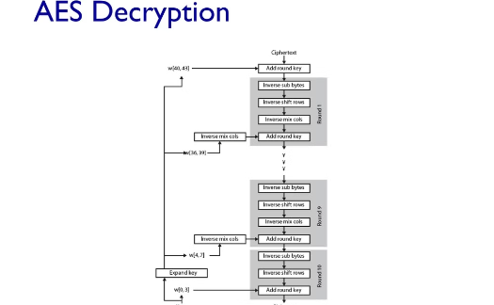
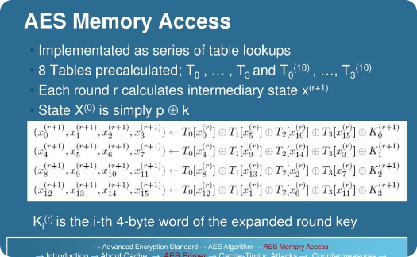
AES Performance Optimization
Optimized AES Encryption
Optimized AES Decryption
Memory-Efficient AES
Implement techniques like lookup tables, pipeline parallelism, and hardware acceleration to enhance the encryption speed of AES, enabling faster data processing and improved throughput.
Apply similar optimization strategies to the decryption process, ensuring that both encryption and decryption operations are executed efficiently, without compromising the overall security of the AES algorithm.
Optimize memory usage by implementing techniques like in-place AES, reduced key schedules, and efficient key management, enabling the AES implementation to run on resource-constrained devices with limited memory.

Slide 10



AES Security Considerations
Key Length
Side-Channel Attacks
Cryptanalysis
AES supports key sizes of 128, 192, and 256 bits, providing strong encryption for sensitive data.
Careful implementation is crucial to prevent side-channel attacks that can compromise AES encryption.
AES has withstood extensive cryptanalysis, demonstrating its robustness against various attacks like differential and linear cryptanalysis.

Slide 11

Conclusion and Future Enhancements
This comprehensive implementation of the AES block cipher in Python showcases the power and versatility of this robust encryption standard. Looking ahead, future enhancements may include support for parallel processing, hardware acceleration, and integration with popular cryptography libraries for seamless deployment.

Slide 12
Thank You

